Slide 1
Thesis progress
Narrowing down the topic

Slide 2
Agencies
Nepal Electricity Authority (NEA)
national utility (type of utility called)
Department of Hydrology and Meteorology (DHM)
the main Meteorological body in Nepal
International Centre for Integrated Mountain Development (ICIMOD)
an intergovernmental research institute based in Kathmandu
oversees activities in the Hindu-Kush-Himalayas region

Slide 3
Hydropower sector needs
Contacted grid operators and hydropower owners
Both pointed streamflow as more valuable information

Slide 4
Operational streamflow forecasts
10 day ensemble streamflow forecast.
hosted by ICIMOD
downscaling of GloFAS forecast.
routing done using RAPID model
GloFAS
51 member ensemble
precipitation forecasts
resolution:
runoff forecast based on (HTESSEL) model

Slide 5
21 September 2021
Fixed errors in previous bias correction approach
Added linearly weighted bias correction
Currently using reanalysis as observation.
Made preliminary plots
hit and miss
need to explore for more date ranges
days with available fcst obs data pairs
future 10 days fcst where bias correction is applied.
bias correction window

Slide 6
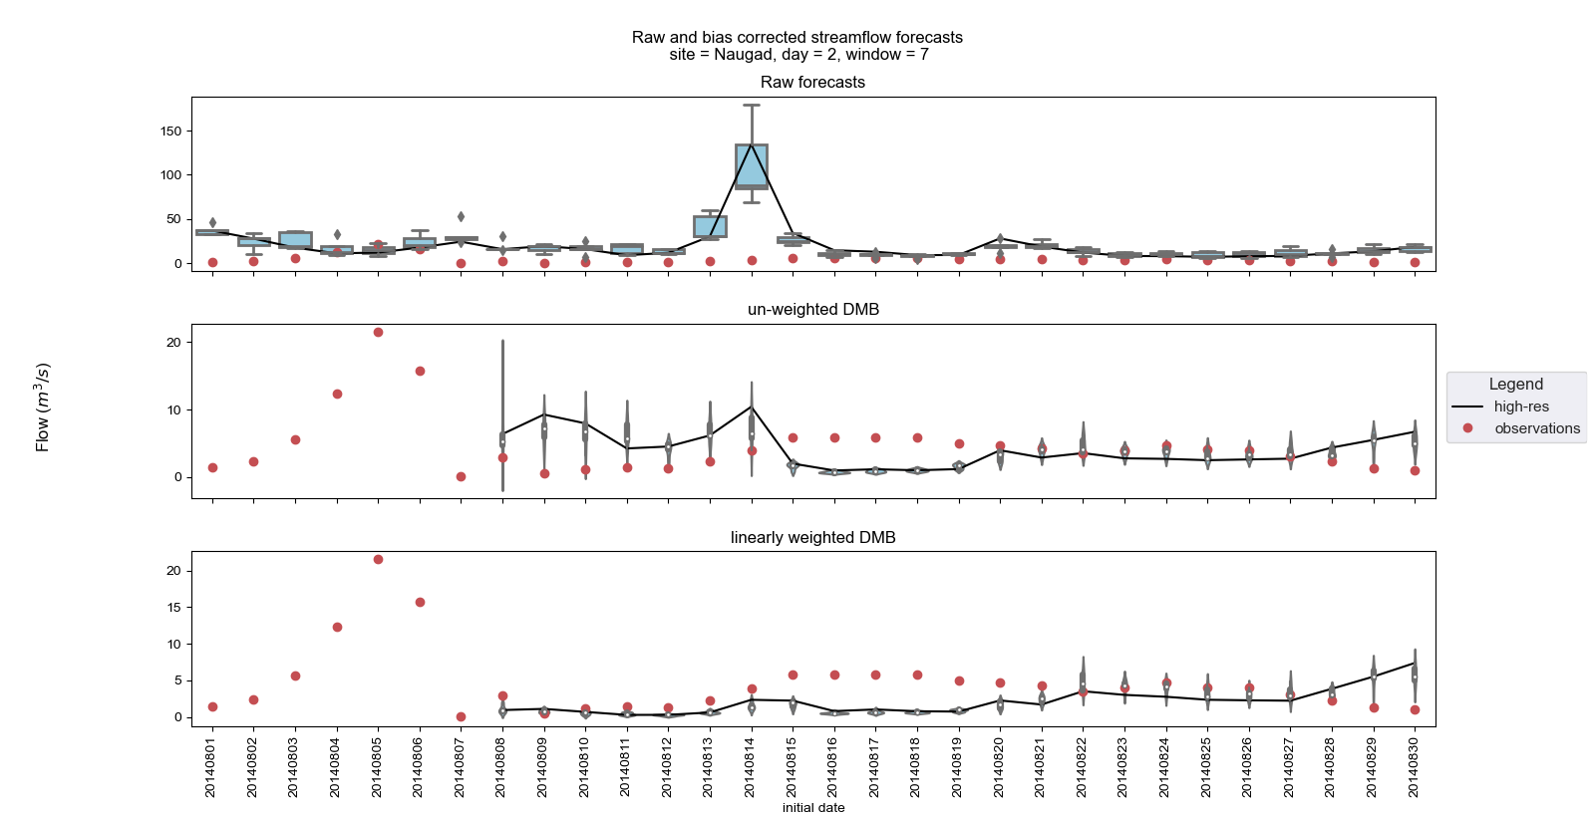
August 2014

Slide 7
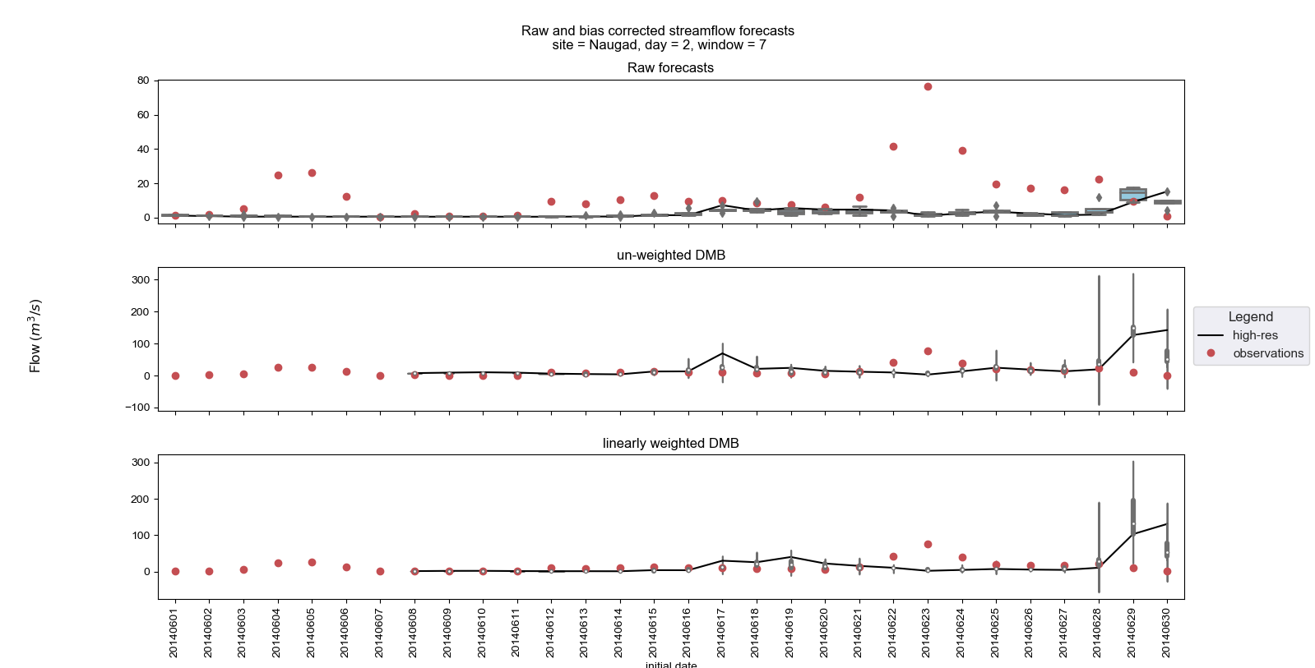
June 2014

Slide 8
Work for this week
Check the performance for different window lengths and different forecasts days
Check for the other 2 hydro sites
apply the NS coefficient

Slide 9
Other
Course FRST 538

Slide 10
October 5, 2021
Switched to plotly:
interactive plotting
easy to pan around and explore multiple date ranges
needs more work
some advice on visualisation for big data
on-site observed data
application submitted. was told 3-4 days after payment is done
explore data from one of the sites available
only for the high flow season.
thesis writing
checked formatting requirements

Slide 11
Next week
results from the high flow data of from one of the HPP sites:
plots
Nash-Sutcliffe score
general performance of the bias correction schemes
some progress with writing
Other verification statistics – contact Greg West
look into WRF solar code and check the parameterizations used.

Slide 12
Oct 13, 2021
NSE calculation
idea for new module exercise using WRF solar

Slide 13
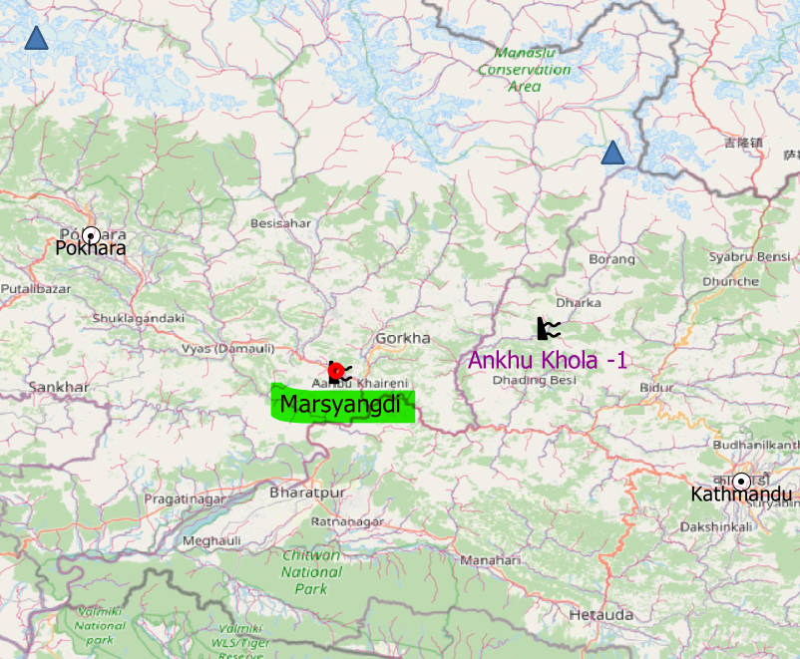
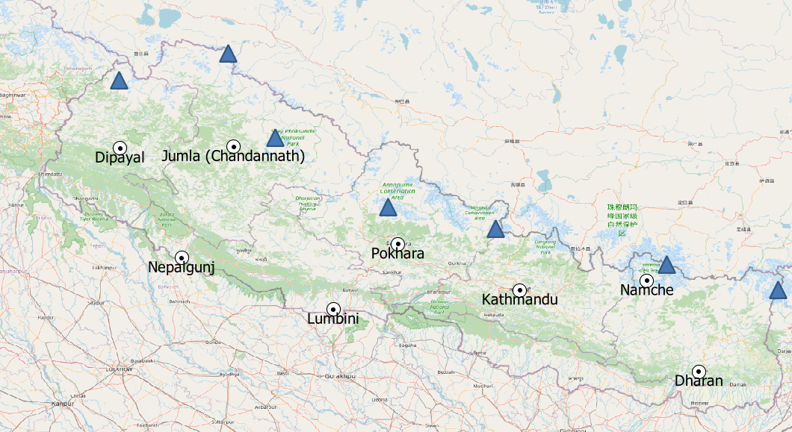
Ground based measurement
Site: Marsyangdi
Location: central Nepal
data used:
start: May 14, 2020
end: Dec 15, 2020

Slide 14
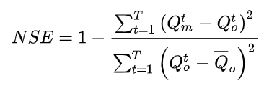
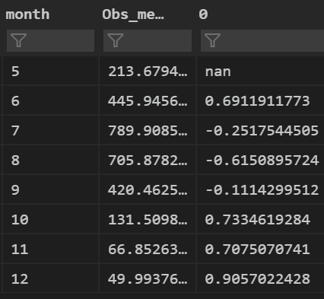
NSE
Q_m = modelled | Q_o = observed
Q_o(bar) = climatology values
May has nans because of DMB
need to work on it
NSE >0.7 good, NSE>0.9 ideal
NSE < 0 better to stick with climatology
NSE

Slide 15
NSE limitations
affected by extreme outliers
months 7-9 peak monsoon
high variability in the model outputs
show plot
Next work:
explore getting rid of outliers for the NSE
try ensemble median

Slide 16
ATSC 313
new exercise for one of the modules
provide student WRF solar output in csv
compare with observed conditions
what decision would they make?
Add a new LG topic
add specific components of wrf solar that make them unique to wrf discussed in hydro or wind

Slide 17
Future work
Meet Werner
incorporate ensemble mean
in the plot
for the NSE analysis
implement frcst vs obs plot

